Slide 1
Pointers

Slide 2
This lecture contains dangerous pointer use and low-level programming from the outset and throughout

Slide 3
Pointer Fundamentals
When a variable is defined the compiler (linker/loader actually) allocates a real memory address for the variable.
  int x; will allocate 4 bytes in the main memory, which will be used to store an integer value.
When a value is assigned to a variable, the value is actually placed to the memory that was allocated.
  x=3; will store integer 3 in the 4 bytes of memory.
00000000
00000000
x
00000000
00000011

Slide 4
Pointers
When the value of a variable is used, the contents in the memory are used.
  y=x; will read the contents in the 4 bytes of memory, and then assign it to variable y.
&x can get the address of x. (referencing operator &)
The address can be passed to a function:
  scanf("%d", &x);
The address can also be stored in a variable ……
00000000
00000000
x
00000000
00000011
y

Slide 5
Pointers
To declare a pointer variable
  type * pointername;
For example:
  int * p1; p1 is a variable that can point to an integer, (or p1 is a int pointer)
  char *p2;
  unsigned int * p3;
p1 = &x; /* Store the address in p1 */
scanf("%d", p1); /* i.e. scanf("%d",&x); */
p2 = &x; /* Will get warning message */

Slide 6
Initializing Pointers
Like other variables, always initialize pointers before using them!!!
For example:
  int main(){
  int x;
  int *p;
  scanf("%d",p); /* */
  p = &x;
  scanf("%d",p); /* Correct */
  }
Don’t

Slide 7

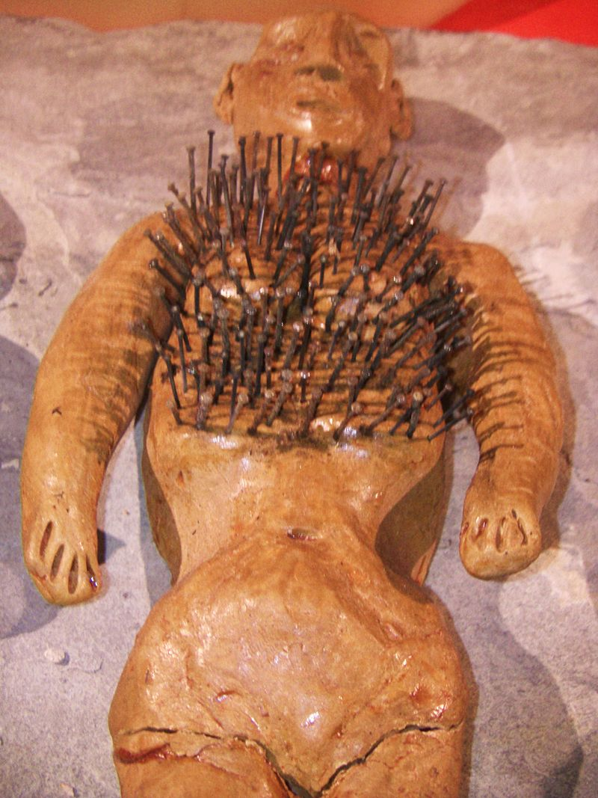

Using Pointers
Pointers can be used to modify variables through a level of indirection

Slide 8
Using Pointers
You can use pointers to access the values of other variables, i.e. the contents of the memory for other variables.
To do this, use the * operator (dereferencing operator).
  Depending on different context, * has different meanings.
For example:
    int n, m=3, *p;
    p=&m;
    n=*p;
    printf("%d\n", n);
    printf("%d\n",*p);

Slide 9
An Example
  int m=3, n=100, *p;
  p=&m;
  printf("m is %d\n",*p);
  m++;
  printf("now m is %d\n",*p);
  p=&n;
  printf("n is %d\n",*p);
  *p=500; /* *p is at the left of "=" */
  printf("now n is %d\n", n);

Slide 10
Pointers as Function Parameters
Sometimes, you want a function to assign a value to a variable.
  e.g. scanf()
E.g. you want a function that computes the minimum AND maximum numbers in 2 integers.
Method 1, use two global variables.
  In the function, assign the minimum and maximum numbers to the two global variables.
  When the function returns, the calling function can read the minimum and maximum numbers from the two global variables.
This is bad because global variables are evil.
  And the function is not reusable.

Slide 11
Pointers as Function Parameters
Instead, we use the following function
void min_max(int a, int b,
int *min, int *max){
if(a>b){
*max=a;
*min=b;
}
else{
*max=b;
*min=a;
}
}
int main()
{
int x,y;
int small,big;
printf("Two integers: ");
scanf("%d %d", &x, &y);
min_max(x,y,&small,&big);
printf("%d <= %d", small, big);
return 0;
}

Slide 12

Pointer Arithmetic

Slide 13
Pointer Arithmetic
When a pointer variable points to an array element, there is a notion of adding or subtracting an integer to/from the pointer.elements
int a[ 10 ], *p;
p = &a[2];
*p = 10;
*(p+1) = 10;
printf("%d", *(p+3));
int a[ 10 ], *p;
a[2] = 10;
a[3] = 10;
printf("%d", a[5]);
p
p+1
p+2
p+3
p+4
p+5
p+6
p+7
a
a[0]
a[1]
a[2]
a[3]
a[4]
a[5]
a[6]
a[7]
a[8]
a[9]

Slide 14
Pointer Arithmetic
More examples:
  int a[10], *p, *q;
  p = &a[2];
  q = p + 3; /* q points to a[5] now */
  p = q – 1; /* p points to a[4] now */
  p++; /* p points to a[5] now */
  p--; /* p points to a[4] now */
  *p = 123; /* a[4] = 123 */
  *q = *p; /* a[5] = a[4] */
  q = p; /* q points to a[4] now */
  scanf("%d", q) /* scanf("%d", &a[4]) */

Slide 15
Pointer Arithmetic
If two pointers point to elements of a same array, then there are notions of subtraction and comparisons between the two pointers.
  int a[10], *p, *q , i;
  p = &a[2];
  q = &a[5];
  i = q - p; /* i is 3*/
  i = p - q; /* i is -3 */
  a[2] = a[5] = 0;
  i = *p - *q; /* i = a[2] – a[5] */
  p < q; /* true */
  p == q; /* false */
  p != q; /* true */

Slide 16
Pointers and Arrays
Recall that the value of an array name is also an address.
In fact, pointers and array names can be used interchangeably in many (but not all) cases.
  E.g. int n, *p; p=&n;
  n=1; *p = 1; p[0] = 1;
Two major differences are:
  Array names come with valid spaces where they “point” to. And you cannot “point” the names to other places.
  Pointers do not point to valid space when they are created. You have to point them to some valid space (initialization).
  Arrays have a constant address

Slide 17
Using Pointers to Access Array Elements
A pointer can be used just like an array
int a[ 10 ], *p;
p = &a[2];
p[0] = 10;
p[1] = 10;
printf(“%d”, p[3]);
int a[ 10 ], *p;
a[2] = 10;
a[3] = 10;
printf(“%d”, a[5]);
p
p[0]
p[1]
p[2]
p[3]
p[4]
p[5]
p[6]
p[7]
a
a[0]
a[1]
a[2]
a[3]
a[4]
a[5]
a[6]
a[7]
a[8]
a[9]

Slide 18
An Array Name is Like a Constant Pointer
Array name is like a constant pointer which points to the first element of the array.
  int a[10], *p, *q;
  p = a; /* p = &a[0] */
  q = a + 3; /* q = &a[0] + 3 */
  a ++; /* illegal !!! */
Therefore, you can “pass an array” to a function. Actually, the address of the first element is passed.
  int a[ ] = { 5, 7, 8 , 2, 3 };
  sum( a, 5 ); /* Equal to sum(&a[0],5) */
  ……….

Slide 19
An Example
/* Sum – sum up the ints in the given array */
int sum(int *a, int size)
{
int i, s= 0;
for(i = 0; i<size;i++){
s+=a[i];
}
return s;
}
/* In another function */
int a[1000],x;
……
x= sum(&a[100],50);
/* This sums up a[100], a[101], …, a[149] */

Slide 20
Allocating Memory at Execution Time
When we declare local variables, the memory for those variables is allocated automatically
float avg, stdev;
float * metric;
Each of these variables has a name
We can get the address of local variables using the & operator
metric = &stdev;
Now we have this pointer, we can refer to the piece of memory storing the standard deviation variable as either of:
  stdev
  *metric

Slide 21
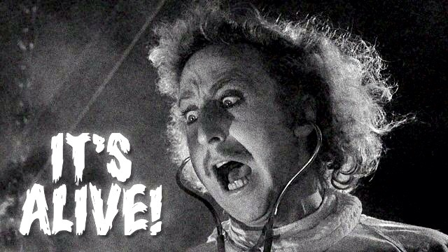
Allocating Memory at Execution Time

Slide 22
Allocating Memory at Execution Time
In C we can create variables that have no name
  Anonymous variables
We refer to anonymous variables only with pointers
An anonymous variable without a pointer is unreachable
  This is how automatic garbage collection works in languages like Java
  The garbage collector finds all reachable anonymous variables, and collects all unreachable anonymous variables
  There is no automatic garbage collection in C
You never declare anonymous variables
  Instead you create them using the malloc function
    malloc is short for memory allocate
  “malloc” is the C equivalent of “new” in Java

Slide 23
Allocating Memory At Execution Time
Simple example of malloc
#include <stdio.h>
#include <stdlib.h>
int main(){
int *p;
p = malloc( sizeof(int) ); /* Allocate 4 bytes */
scanf("%d", p);
printf("%d", *p);
free(p); /* This returns the memory to the system.*/
/* Important !!! */
}

Slide 24
Dynamically-allocated arrays
In the original C standard arrays had to be of a constant size
int a[1024];
Although since the C99 standard, the size can be a variable expression
int a[size];
However, you can also use malloc to allocate a block of memory of any size
  The result of malloc is always stored in a pointer
  In C pointers can be treated very much like arrays
  So you can use malloc to dynamically allocate blocks of memory that you can use very much like arrays
  We typically just call these dynamically allocated arrays

Slide 25
Dynamically-allocated arrays
Prototypes of malloc() and free() are defined in stdlib.h
void * malloc(size_t number_of_bytes);
void free(void * p);
You can use malloc and free to dynamically allocate and release the memory;
  int *p;
  p = malloc(1000 * sizeof(int) );
  for(i=0; i<1000; i++)
  p[i] = i;
  p[1000]=3; /* Wrong! */
  free(p);
  p[0]=5; /* Wrong! */

Slide 26
Creating dynamic arrays
You can create a new array of ints like this:
int * create_int_array(int size) {
  int *p;
  p = malloc(size * sizeof(int) );
  if ( p == NULL ) {
  fprintf(stderr, “FATAL: out of memory\n”);
  }
  return p;
}

Slide 27
Dynamic arrays
Dynamically created arrays can be used and passed around just like regular arrays
The main difference is that dynamically created arrays are anonymous variables with no name
Therefore, when you are finished with a dynamically created array, you must release it explicitly
  free(p);

